Slide 1

REGRESSION & CURVE FITING
DSML

Slide 2

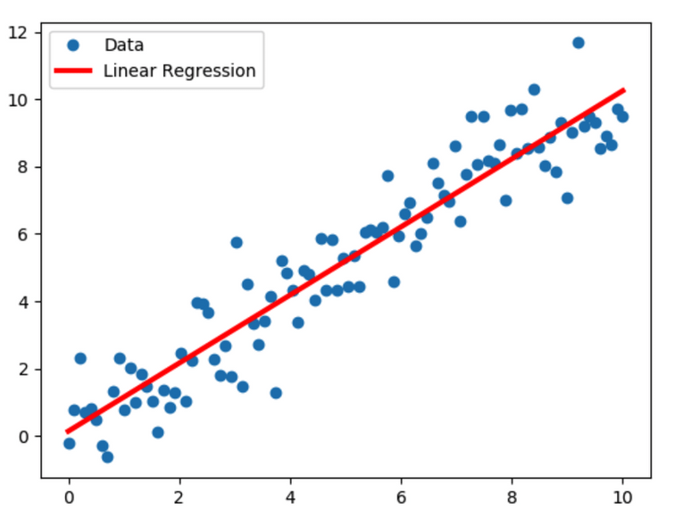
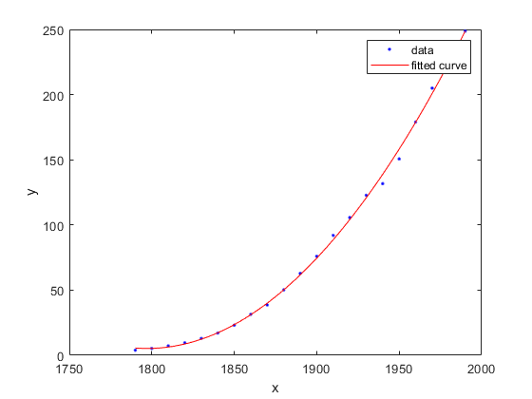
FITTING FUNCTIONS TO DATA POINTS
Regression is the process of determining the relationship between a dependent variable and one or more independent variables
Data Squad | Statistics Introdution

Slide 3
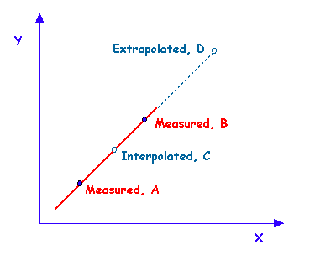
WHAT IS REGRESSION USEFUL FOR?
Interpolation:
Make predictions about values within measured range of sample
Extrapolation:
Make predictions beyond range of datapoints available
Data Squad | Statistics Introdution

Slide 4
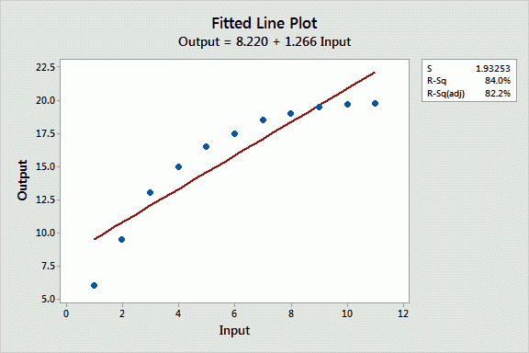
CHALLENGES IN REGRESSION
What is the function family that we should use to
Perform our fit? What are the best parameters to fit the function to the data?
Data Squad | Statistics Introdution

Slide 5
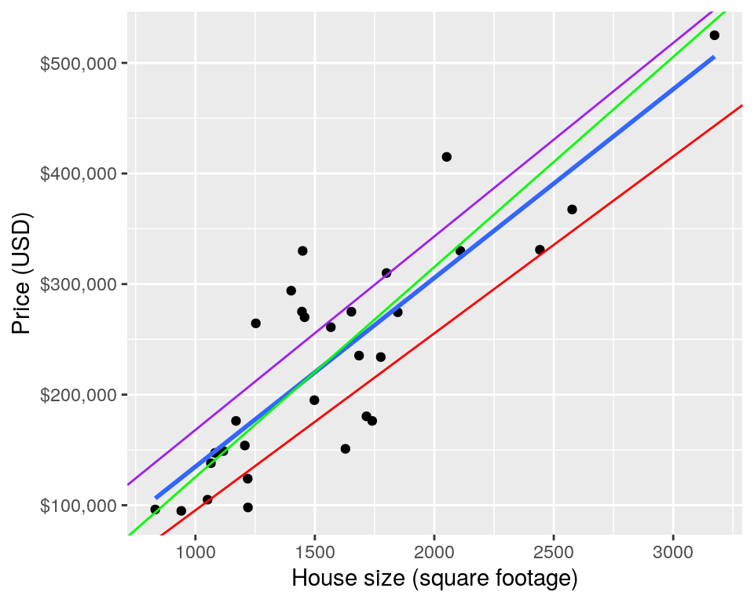
CHALLENGES IN REGRESSION
What is the function family that we should use to perform our fit?
What are the best parameters to fit the function to the data?
Data Squad | Statistics Introdution

Slide 6

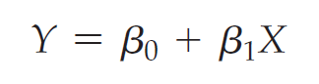
LINEAR REGRESSION
A straight LINE IS GIVEN BY THE EXPRESSION BELLOW
Beta_0 is the y-intercept
Beta_1 is the gradient
Data Squad | Statistics Introdution

Slide 7
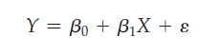
LINEAR REGRESSION MODEL
In practice we know that other variables may impact the target variable.
These are assumed to be part of the random error
Notes:
For regression to be effective, the random errors are assumed to be modelled by a normal distribution with mean 0
The most common method to then extract the best values of the model parameters is known as least squares regression
Data Squad | Statistics Introdution

Slide 8

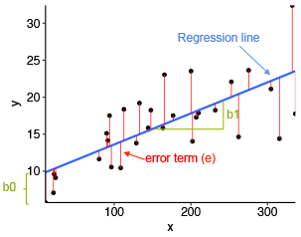
LINEAR REGRESSION MODEL
Data Squad | Statistics Introdution

Slide 9
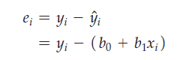
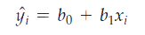
HOW EXACTLY DO WE GET THOSE VALUES?
Find b0 and b1 that minimize this value:
Prediction
Each residual is the real value minus it's prediction: the error!
Data Squad | Statistics Introdution

Slide 10
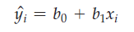
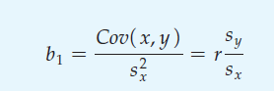
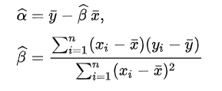
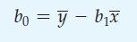
HOW EXACTLY DO WE GET THOSE VALUES?
PREDICTION
WE CAN COMPUTE THE COEFFICIENTS BY:
OR IN AN ALTERNATIVE NOTATION
Data Squad | Statistics Introdution

Slide 11
REFERENCES
Chapter 11, newbold, calson, thorne, statistics for business & economics
Data Squad | Statistics Introdution

Slide 12


ANY QUESTIONS ?

